Slide 1
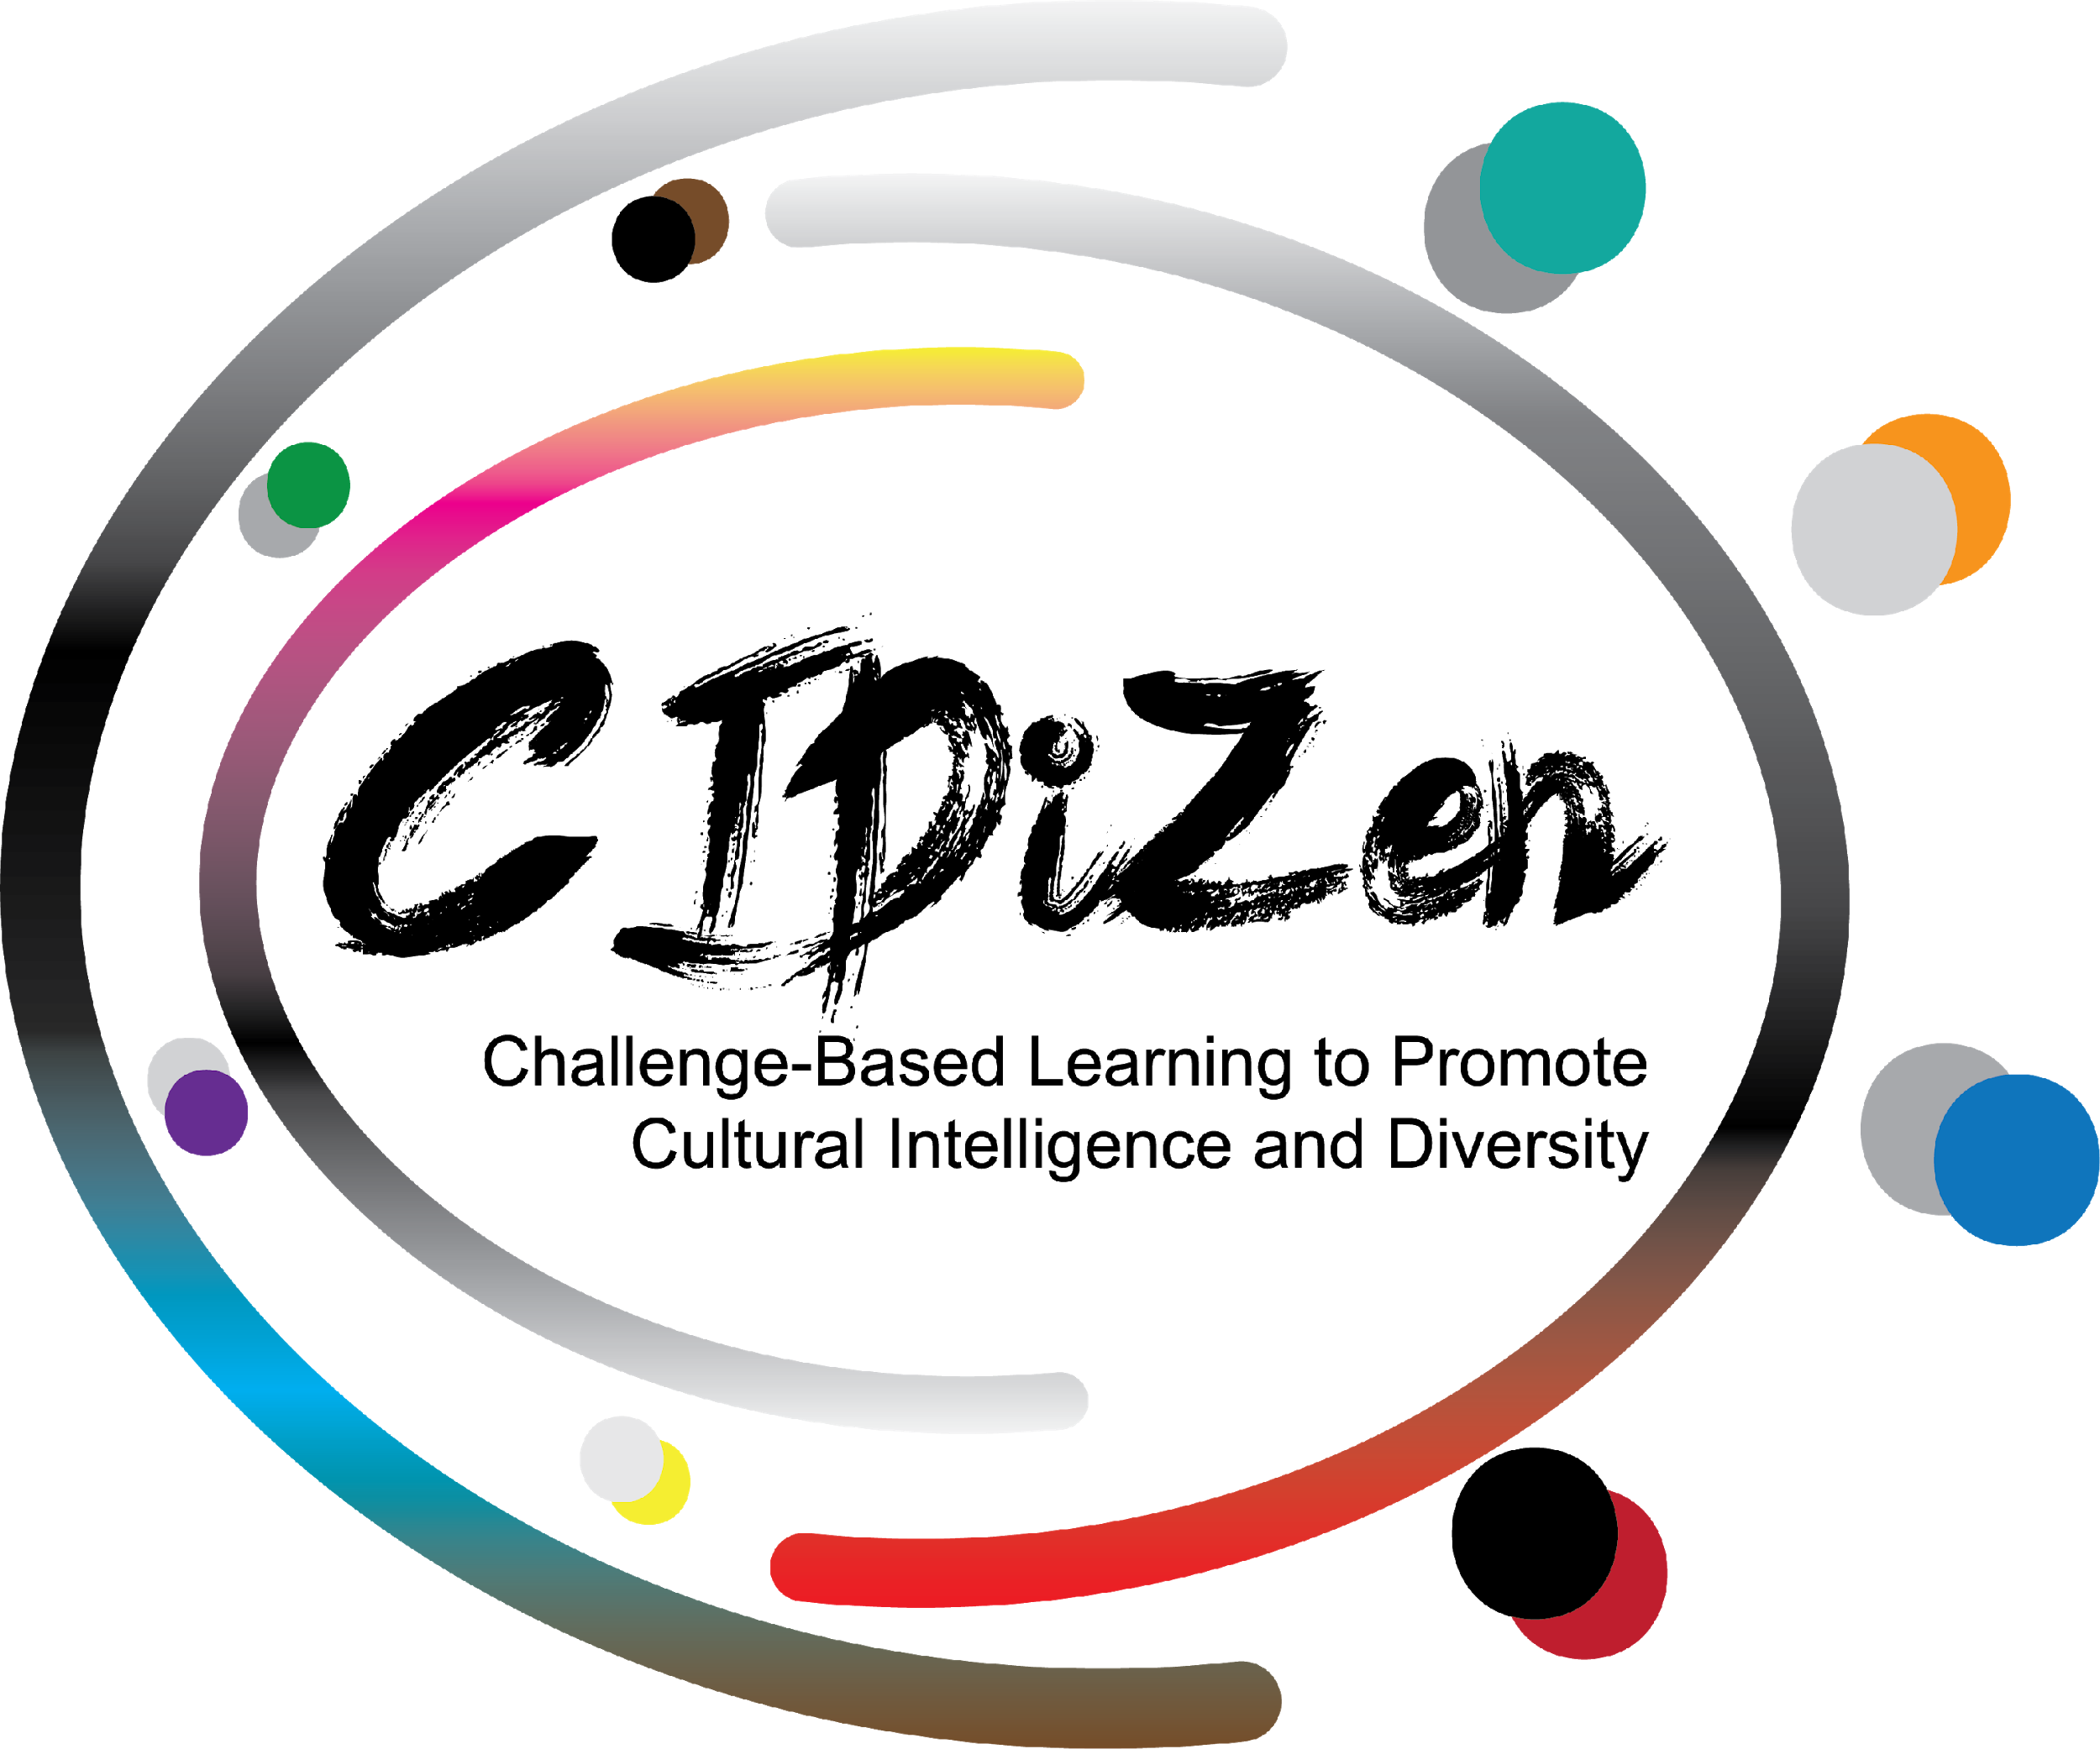
Cultural Value
Orientation
Theory and Value Orientation Method

Slide 2
CULTURAL VALUE ORIENTATION
Cultural value orientations represent the basic and core beliefs of culture; these basic beliefs deal with human relationships with one another and with their world.
These are basic convictions that people have regarding what is:
Right or Wrong
Good or Bad
Important or Unimportant
Should be avoided or accepted

Slide 3
Cultural Value Orientation Theory
The Kluckhohn-Strodtbeck Value Orientations theory represents one of the earliest efforts to develop a cross-cultural theory of values. According to Kluckhohn and Strodtbeck (1961), every culture faces the same basic survival needs and must answer the same universal questions. It is out of this need that cultural values arise.
The basic questions faced by people everywhere fall into five categories and reflect concerns about:
1) Human nature
2) The relationship between human beings and the natural world
3) Time
4) Human activity
5) Social relations

Slide 4
Kluckhohn-Strodtbeck Values Orientation Theory
Notes:
Source: https://press.rebus.community/originsofthehumanfamily/chapter/chapter-6-a-closer-look-at-values/#chapter-351-section-1

Slide 5
Cross Cultural Value Orientations
BASIC NATURE OF PEOPLE
Whether they view people as good, evil, or some mix between these two.
RELATION TO NATURE
How people relate to the natural world around them and to the supernatural.
TIME ORIENTATION
The culture focus on the past, present, or future.
ACTIVITY ORIENTATION
How to live: being or living in the moment, doing or controlling
RELATIONSHIPS AMONG PEOPLE
The degree of responsibility people has for others.
Notes:
Source: www.studsplanet.com

Slide 6
Value Orientations Method
To use Kluckhohn-Strodtbeck Value Orientations theory as a method, they created an original assessment instrument, called the Value Orientations Survey. The method is often referred to as the VOM (Value Orientation Method).
This survey comprises 23 oral questions. The "questions" begin with a situation or story that provides the basis for questions that elicit respondent's preferences.
Notes:
Source: www.studsplanet.com

Slide 7
Example of a question from the VOM survey
Some people were talking about how children should be brought up. Here are three original ideas:
Some people say that children should always be taught the traditions of the past. They believe the old ways are best, and it is when children do not follow them that things go wrong. (A)
Some people say that children should be taught some of the old traditions, but it is wrong to insist that they stick to these ways. These people believe it is necessary for children to always learn about and take on whatever of the alternative ways will best help them get along in the world of today. (B)
Some people do not believe children should be taught much about the past traditions at all, except as an interesting story. These people believe that the world goes along best when children are taught the things that will make them want to find out for themselves new ways of doing things to replace the old. (C)
Notes:
Which of these people has the best idea about how children should be taught?
(Orientations: A = past, B = present, C = future)

Slide 8
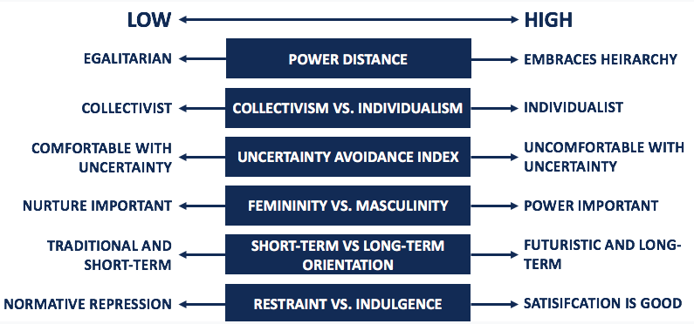
The culture dimensions

Slide 9
Power Distance
The power distance index considers the extent to which it tolerates inequality and power. In this, they viewed inequality and power from the viewpoint of the followers – the lower level.
The high power distance index shows that a culture accepts inequity and power differences, encourages bureaucracy and shows high respect for rank and authority.
Low power distance index values are more egalitarian. For instance, there is more equality between parents and children with parents more likely to accept it if children argue with them, or “talk back”. These cultures will encourage organizational structures that are flat and feature decentralized decision-making responsibility.

Slide 10
Individualism vs. Collectivism
The individualism vs. collectivism dimension considers the degree to which they integrate societies into groups and their perceived obligations and dependence on groups.
Individualism shows that there is a greater importance placed on attaining personal goals. A person’s self-image in this category is defined as “I.”
Collectivism shows that there is a greater importance placed on the goals and well-being of the group. A person’s self-image in this category is defined as “We”

Slide 11
Uncertainty Avoidance Index
The uncertainty avoidance index considers the extent to which they tolerated uncertainty and ambiguity. This dimension considers how unknown situations and unexpected events are dealt with.
A high uncertainty avoidance index shows a low tolerance for uncertainty, ambiguity, and risk-taking. The unknown is minimized through strict rules, regulations, etc.
A low uncertainty avoidance index shows a high tolerance for uncertainty, ambiguity, and risk-taking. The unknown is more openly accepted, and there are lax rules, regulations, etc.

Slide 12
Masculinity vs. Femininity
The masculinity vs. femininity dimension is also referred to as “tough vs. tender,” and considers the preference of society for achievement, attitude towards sexuality equality, behavior, etc.
Masculinity comes with the following characteristics: distinct gender roles, assertive, and concentrated on material achievements and wealth-building.
Femininity comes with the following characteristics: fluid gender roles, modest, nurturing, and concerned with the quality of life

Slide 13
Long-Term vs. Short-Term Orientation
The long-term orientation vs. short-term orientation dimension considers the extent to which society views its time horizon.
Long-term orientation shows focus on the future and involve delaying short-term success or gratification in order to achieve long-term success. Long-term orientation emphasizes persistence, perseverance, and long-term growth.
Short-term orientation shows focus on the near future, involves delivering short-term success or gratification, and places a stronger emphasis on the present than the future. Short-term orientation emphasizes quick results and respect for tradition.

Slide 14
Indulgence vs. Restraint
The indulgence vs. restraint dimension considers the extent and tendency of a society to fulfill its desires. In other words, this dimension revolves around how societies can control their impulses and desires.
Indulgence indicates that society allows relatively free gratification related to enjoying life and having fun.
Restraint shows that society suppresses gratification of needs and regulates it through social norms

Slide 15
“The European Commission’s support for the production of this publication does not constitute an endorsement of the contents, which reflect the views only of the authors, and the Commission cannot be held responsible for any use which may be made of the information contained therein.”
2020-1-DK01-KA205-074945

