Slide 1
Migration
in Europe

Slide 2
IMMIGRATION TO EUROPE
Immigration to Europe has a long history but increased substantially in the later 20th century. Western European countries, especially, saw a high growth in immigration after World War II and many European nations today have sizeable immigrant populations, both of European and non-European origin.
In contemporary globalization, migrations to Europe have sped up in speed and scale. Over the last decades, there has been an increase in negative attitudes towards immigration, and many studies have emphasized marked differences in the strength of anti-immigrant attitudes among European countries.

Slide 3
IMMIGRANTS
Beginning in 2004, the European Union has granted EU citizens freedom of movement and residence within the EU, and the term "immigrant" has since been used to refer to non-EU citizens, meaning that EU citizens are not to be defined as immigrants within the EU territory.
The European Commission defines "immigration" as the action by which a person from a non-EU country establishes his or her usual residence in the territory of an EU country for a period that is or is expected to be at least twelve months.
Between 2010 and 2013, around 1.4 million non-EU nationals, excluding asylum seekers and refugees, immigrated into the EU each year using regular means, with a slight decrease since 2010.

Slide 4
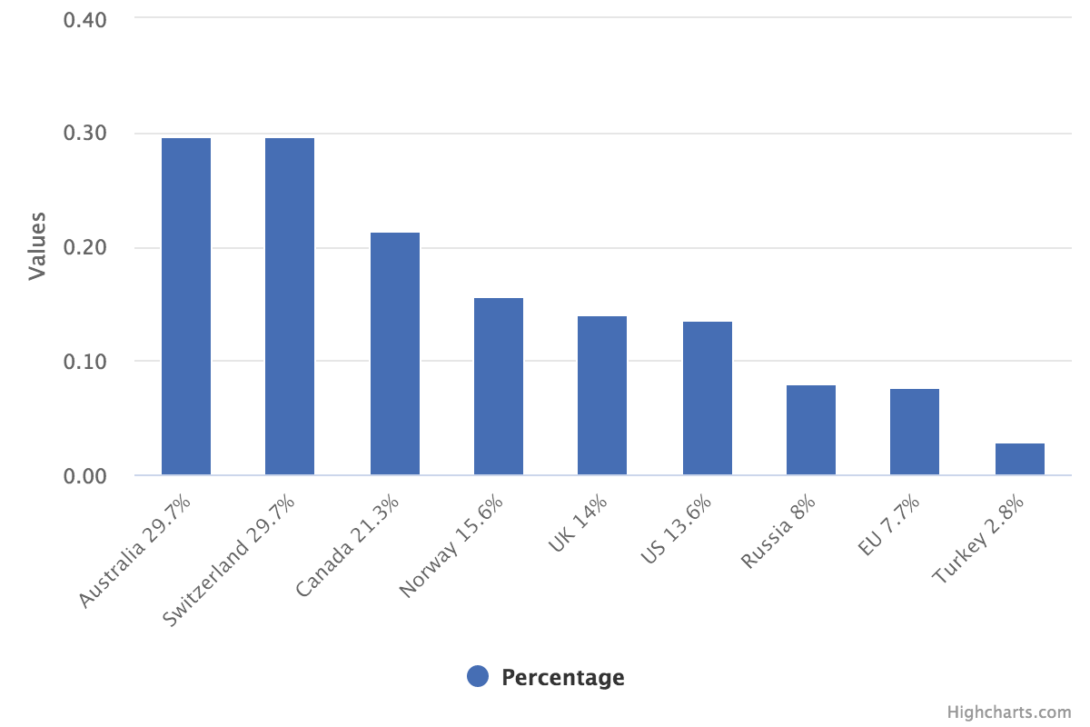
Foreign-born residents
Notes:
The share of foreign-born population in the EU is lower than in most developed countries.
Source: Eurostat, OECD, UNDESA, data from 2018 or 2019
Note: non-EU born in case of the EU (i.e. those born in another Member State are not included); if intra-EU mobile persons were included, the share would be 11.9%

Slide 5
Why people migrate
Every story of migration or displacement begins with an intensely personal drama. Leaving home is a momentous decision, whether a hasty bid to escape death or through the careful balancing of risks and rewards. For some, it is driven by dreams and responsibilities to family or community. For others, it is a desperate bid for survival.
The former is usually called migrants and the latter refugees, even though in actual life these categories are intertwined and fluid. People may flee death to a neighboring country, for example, but find themselves destitute there and try to move again. Or they leave home to pursue their dreams but are enslaved and tortured along the route, and seek a way out.

Slide 6
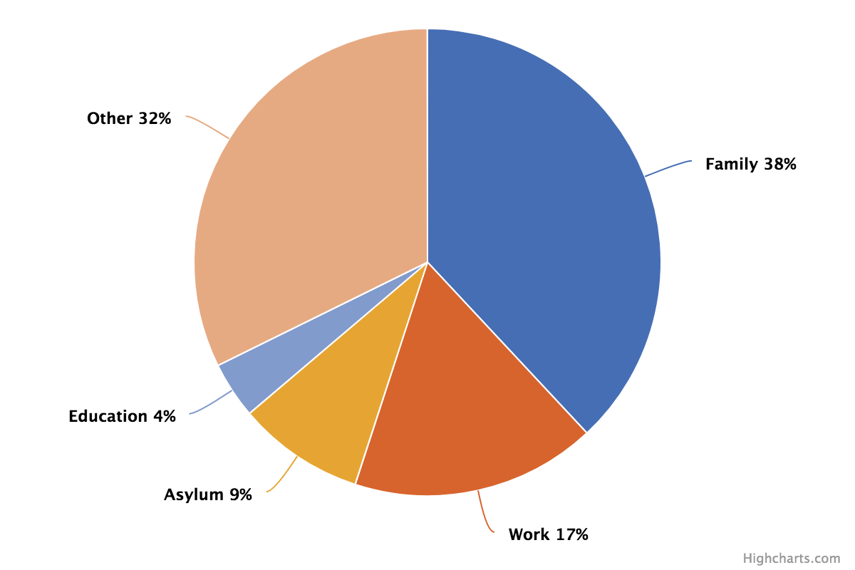
Reasons for coming to Europe
Notes:
Source: Eurostat
The most important reason to come to the EU for people with a valid residence permit at the end of 2019 was family reasons.

Slide 7
Why people migrate
Conflict: Syrians, Afghans, South Sudanese, and Myanmar’s Rohingya make up around half the world’s registered refugees.
Political and economic instability: Some two billion people live in “fragile” countries that are affected by violence and displacement but whose institutions have little capacity to cope, according to the OECD.
Climate change: The effects of climate change could force tens of millions of people to migrate within their own countries by 2050, according to the World Bank.

Slide 8
Extra attention on migration
Over 60 million people across the globe are fleeing conflict, poverty, and persecution, either within their home countries or by fleeing abroad.
For years now, a comparatively small proportion of these people have been attempting to make their way to Europe–to countries with welcoming asylum status policies.
Refugees from across the world have attempted to reach Europe for decades, so why are people just paying attention this year? Several crises across the Middle East and North Africa have created the ‘perfect storm’ for a refugee crisis.

Slide 9
SYRIAN CRISES
Now, in its fifth year, there is no sign of the Syrian conflict abating. People still living in the country have all but given up hope, and the Syrians living in neighboring countries see little chance of returning home. They are now coming to terms with the fact they may have to look for a permanent solution to where they will live, and many are therefore seeking refuge in Europe.
An astonishing 7.6 million Syrians have been internally displaced, with a further 4.1 million having fled to Egypt, Iraq, Jordan, Lebanon, and Turkey. But only around 394,000 Syrians have sought refuge in Europe since April 2011.

Slide 10
MIDDLE EAST
Other insecurities in the Middle East are contributing to the crisis. The conflict in Yemen, where entire neighborhoods have been designated as military targets, has led more than 100,000 people to leave their country.
In Iraq, the advance of the so-called ‘Islamic State’ has led many to flee for their lives. The UNHCR estimate that 400,000 Iraqis are currently seeking refugee status.
*UNHCR, the UN Refugee Agency, is a global organization dedicated to saving lives and protecting the rights of refugees

Slide 11
NORTH AFRICA
The collapse of the government in Libya has left tens of thousands of migrant workers from areas such as West Africa, South Asia, and the Middle East stranded at the hands of rivaling militias. For most of these people, the only way of leaving the country is by boat across the Mediterranean.
In Egypt, which is now home to over 130,000 Syrian refugees, the change in government has led to a loss of sympathy for Syrian refugees–if many Syrians feel the need to leave.
A staggering three percent of Eritrea’s population has fled the totalitarian state, led by a brutal dictatorship where most citizens fear arrest at any moment.

Slide 12
RESETTLEMENT
In 2019, around 21,200 people in need of international protection were resettled from non-EU countries to the EU Member States, 12% more than in 2018.
The highest number of departures was recorded in Turkey. Syrian was by far the main nationality, accounting for 60% of people resettled.
Under joint EU resettlement schemes, over 75,000 persons found protection in the EU since 2015. Member States receive support from the EU budget for these resettlements.

Slide 13
MIGRATION BY NUMBERS
The overall numbers of migration in the entire world:
Nearly 71 million people are currently displaced.
Almost 26 million of them are refugees who fled to another country.
About half of the world’s refugees are children under the age of 18 years old.
More than 60 percent of refugees live in cities. Less than one-third live in camps.
Some 3.5 percent of the world’s population are international migrants.

Slide 14
Legal migration
Migration is not a threat, but a challenge that also offers opportunities for a continent characterized by demographic decline and with labor markets in need of skilled workers. As an essential part of the European Agenda on Migration, channels of legal migration should be fostered and promoted in order to prevent further humanitarian disasters and counter human trafficking.
Persons seeking international protection should be able to apply for a European humanitarian visa in their country of origin directly. With the issuing of visas on humanitarian grounds currently falling outside EU law, efforts made by the European Parliament to include specific provisions in the Union Visa Code are welcomed.

Slide 15
“The European Commission’s support for the production of this publication does not constitute an endorsement of the contents, which reflect the views only of the authors, and the Commission cannot be held responsible for any use which may be made of the information contained therein.”
2020-1-DK01-KA205-074945

